Slide 1

Introduction to Gherkin and Cucumber - 18
Orion Innovation
Company Overview

Slide 2
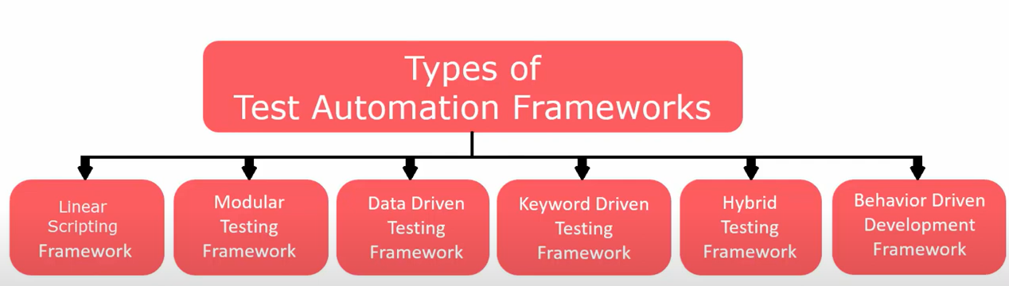
Previous Lesson’s Highlights
Source: [1] Test Automation Frameworks

Slide 3
Content
Gherkin
Cucumber
Installation of Cucumber
Scenario, Scenario Outline and Background

Slide 4
What is Gherkin?

Slide 5
Gherkin
Gherkin is a set of grammar rules.
It defines application behavior using simple English text.
This structured text is understandable by Cucumber.
Scenario: As an existing user, I want to log in successfully.
Given the user is on the Home page
When the user navigates to the Login page
And the user enters the username and password
Then the successful login message is displayed
Source: [2] Scenario with Gherkin format

Slide 6
Gherkin Keywords
The primary keywords are:
Feature
Rule (as of Gherkin 6)
Example (or Scenario)
Given, When, Then, And, But for steps (or *)
Background
Scenario Outline (or Scenario Template)
Examples (or Scenarios)
There are a few secondary keywords as well:
""" (Doc Strings)
| (Data Tables)
@ (Tags)
# (Comments)
Source: [6] Gherkin Keywords

Slide 7
Gherkin Primary Keywords
Feature − Name of the feature under test.
Description (optional) − Describe about feature under test.
Scenario − What is the test scenario.
Source: [7] Gherkin Primary Keywords

Slide 8
Gherkin Primary Keywords
Given − Prerequisite before the test steps get executed.
When − Specific condition which should match in order to execute the next step.
And − It provides the logical AND condition between any two statements. AND can be used in conjunction with GIVEN, WHEN and THEN statement.
But − It signifies logical OR condition between any two statements. OR can be used in conjunction with GIVEN, WHEN and THEN statement.
Then − What should happen if the condition mentioned in WHEN is satisfied.
Source: [7] Gherkin Primary Keywords

Slide 9
Examples
Feature: Shopping Cart Management
Scenario: Add item to the shopping cart
Given the user is on the product page
When the user clicks on the "Add to cart" button for a product
Then the product should be added to the shopping cart
And the cart icon should show the updated item count
Scenario: Remove item from the shopping cart
Given the user has items in the shopping cart
When the user clicks on the "Remove" button for a product
Then the product should be removed from the shopping cart
And the cart icon should show the updated item count
But the total price should be recalculated
Scenario: Update item quantity in the shopping cart
Given the user has items in the shopping cart
When the user changes the quantity of a product
And the user clicks on the "Update cart" button
Then the cart should reflect the new quantity for the product
And the total price should be updated accordingly
But any applied discounts should be recalculated
Feature: User login functionality
Scenario: Successful login with valid credentials
Given the user is on the login page
When the user enters valid credentials
And the user clicks the login button
Then the user should be redirected to the dashboard
And the user should see a welcome message
Scenario: Unsuccessful login with invalid credentials
Given the user is on the login page
When the user enters invalid credentials
And the user clicks the login button
Then the user should see an error message
And the user should remain on the login page
Source: [4] Example test scenarios with Gherkin

Slide 10
What is Cucumber?

Slide 11

Cucumber is an open-source software testing tool written in Ruby.
Cucumber enables you to write test cases that anyone can easily understand regardless of their technical knowledge.
Source: [2] Definition of Cucumber

Slide 12
Cucumber supports various software platforms, including:
Java - Through JUnit and TestNG.
Ruby - Native support with RSpec.
JavaScript - Using Node.js.
Kotlin - With JUnit.
Groovy - Compatible with JUnit and Spock.
Scala - Via JUnit.
Python - Using the Behave framework.
PHP - With Behat.
Perl - Through Test::BDD::Cucumber.
.NET - Using SpecFlow.
Swift - Via Cucumberish.
Objective-C - Using Cucumberish.
Go - Using GoDog.
Erlang - With eCucumber.
Lua - Using Cucumber-lua.
Source: [4] Supported platforms by Cucumber

Slide 13
Benefits of using Cucumber Testing Tools
Cucumber supports different languages like Java.net and Ruby.
It acts as a bridge between the business and technical language. We can accomplish this by creating a test case in plain English text.
It allows the test script to be written without knowledge of any code, it allows the involvement of non-programmers as well.
It serves the purpose of end-to-end test framework unlike other tools.
Due to simple test script architecture, Cucumber provides code reusability.
Source: [5] Advantages of Cucumber

Slide 14
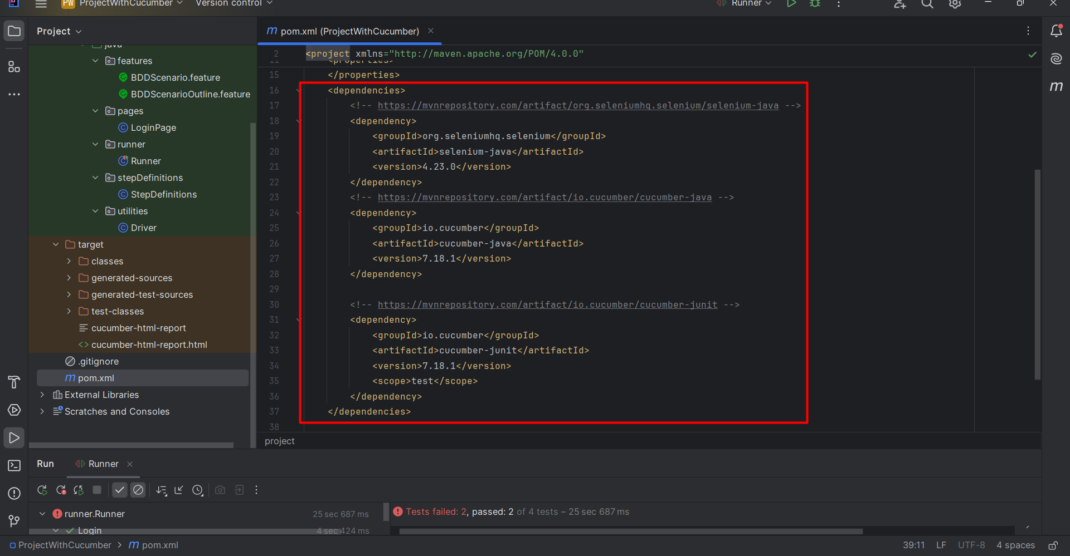
Configure Cucumber with Maven

Slide 15
Cucumber test automation makes use of two important files:
Feature file – Contains code written in Gherkin (plain English text)
Step definition file – Contains the actual code written by the developer
Cucumber acts as a bridge between the following teams:
Business Analysts and Software Engineers
Manual and Automation Test Engineers
Manual Test Engineers and Developers
Source: [2] Cucumber tool for teams

Slide 16
References
[1] https://www.youtube.com/watch?app=desktop&v=3hHL-BhBW4I
[2] https://www.browserstack.com/guide/learn-about-cucumber-testing-tool
[3] https://cucumber.io/docs/gherkin/reference/
[4] https://chatgpt.com/
[5]https://www.tutorialspoint.com/cucumber/cucumber_overview.htm
[6] https://cucumber.io/docs/gherkin/reference/
[7] https://www.tutorialspoint.com/cucumber/cucumber_features.htm

Slide 17
Thanks

